Slide 1

From Data TO DECISION: The Two BRANCHES OF STATISTICS AN INTRODUCTION TO Inferential Statistics
Presenter: Dr. Jorge Sánchez
Affiliation: PhD, University of Glasgow
Notes:
Good morning. My name is Dr. Jorge Sanchez. For the next 15 minutes, I want to take a concept you already understand-like ‘data’– and show you how statistician build a new framework to move from simple facts to powerful, real-world decisions.
My goal today is to give you the fundamental roadmap for every single statistical technique you will learn in this course. In the frequentist school statistics has two main jobs: 1. Description (What did we find?) And 2. Inference (What does it mean?)

Slide 2

Population
Notes:
Population: The population is the entire group you are interested in drawing conclusions about. It is the complete set of all items, individuals, events, or observations that shared a characteristic of interest.
Example: all the apples in an orchard.
Example: All 20,000 enrolled undergraduate students at Sheffield-Hallam University in the current academic year.
Related Term: A value calculated from the population (like the true population mean, u) is called a Parameter
Key characteristic: It is a defining feature that allows to identify what belongs to the Population or Sample. In our example the key characteristic defining our population is “currently enrolled undergraduate status at Sheffiel-Hallam University”, the key characteristic defining the variable is the “daily money spent in lunch”

Slide 3

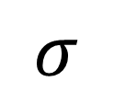
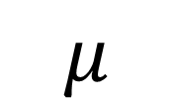
Research Questions
What is the average number of hours per day that young adults in the UK spend on their smartphones?
$$μ$$
$$σ$$
Notes:
Parameter o (The true value): A parameter is a numerical characteristic that describes the entire population. Because it describes the whole truth, it is usually unknown.
The most well-known parameters are the population mean represented and the population standard deviation represented by $μ$ and $σ$

Slide 4
Research Questions
What is the average number of hours per day that young adults in the UK spend on their smartphones?
What is the average lunch cost for all students at this university?
$$μ$$
$$σ$$
Notes:
The population is the source of all parameters

Slide 5
Population
What is the average number of hours per day that young adults in the UK spend on their smartphones?
What is the average lunch cost for all students at this university?
$$μ$$
$$σ$$
What is the average number of hours per week young adults watch TV?
Notes:
Sample: the sample is the data we collect from the population. A sample is a smaller subset of the population that is selected for study. Because studying the entire population is often impractical or impossible, researchers collect data from a sample and use it to draw inferences about the larger population.
Example: A sample of 100 apples we pick from the orchard.
Statistic is a numerical characteristic calculated from the Sample.
For example, parameters that can be estimated are the mean and the variance. Let’s look at some real applications of confidence intervals.
Sample is some representative selection of a population. We hope that the sample is random and representative.

Slide 6
The Core Question
What is the average lunch cost for all students around the university campus?
https://app.wooclap.com/HASMOK?from=instruction-slide
Notes:
Statistical Analysis has two main focuses: Descriptive Statistics and Inferential Statistics
Descriptive Statistics summarised data using graphs and summary values such as the mean and interquartile range.

Slide 7
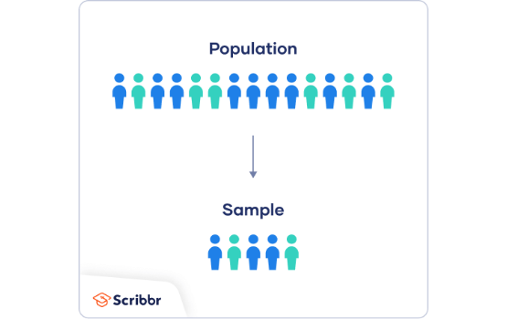
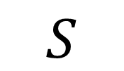
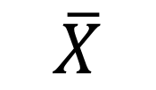
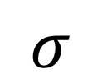
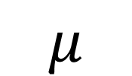
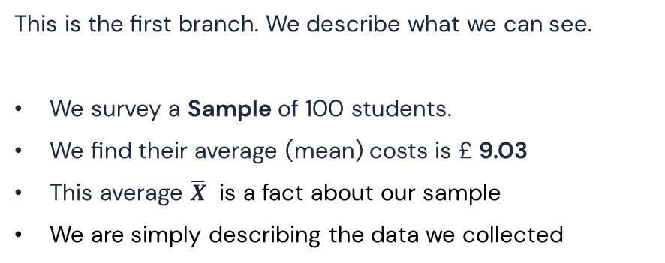
The “Easy” answer: Descriptive Stats
$$μ$$
$$σ$$
Job 1: Descriptive Statistics
This is the first branch. We describe what we can see.
We survey a Sample of 100 students.
We find their average (mean) costs is £ 9.03
This average $\overline{X}$ is a fact about our sample
We are simply describing the data we collected
$$\overline{X}$$
$$S$$
Notes:
In Statistics, parameters of the population are often estimated based on a sample. Therefore, on the one hand we have the population, but in most cases we cannot survey the entire population or we do not have data about the entire population we draw a sample. We want to use this sample to estimate a parameter of the population.

Slide 8

Sample 1
4.77 | 9.58 | 11.44 | 7.65 | 17.83 | 8,1 | 2.49 | 12.65 | 6.9 | 2.46
9.53 | 14.45 | 16.79 | 3.3 | 8.06 | 3.67 | 11.83 | 13.28 | 17.54 | 5.9
18.32 | 3.12 | 2.58 | 1.51 | 18.87 | 5.68 | 4.36 | 7.16 | 3.74 | 13.23
15.66 | 14.29 | 4.96 | 16.94 | 1.82 | 7.07 | 3.39 | 15.13 | 15.36 | 18.52
10.48 | 3.43 | 12.99 | 19.37 | 4.42 | 4.86 | 8.24 | 18.46 | 3.81 | 1.55
5.95 | 4.39 | 8.2 | 5.31 | 4.44 | 3.69 | 8.08 | 6.63 | 3.5 | 7.08
18.58 | 9.92 | 6.75 | 9.63 | 12.53 | 4.57 | 5.29 | 6.23 | 6.19 | 8.88
3.7 | 7.78 | 2.5 | 4.12 | 7.32 | 6.6 | 10.14 | 25.94 | 4.63 | 21.1
5.65 | 7.73 | 14.62 | 7.64 | 20.02 | 5.11 | 5.98 | 5.85 | 4.9 | 11.67
9.57 | 3.53 | 18.32 | 3.5 | 16.27 | 16.14 | 8.14 | 6.95 | 6.09 | 8.71
$$\overline{X}=£8.94$$
Notes:
Descriptive statistics can help us identify relationships and patterns. Descriptive statistics do not draw conclusion beyond the data we already have

Slide 9
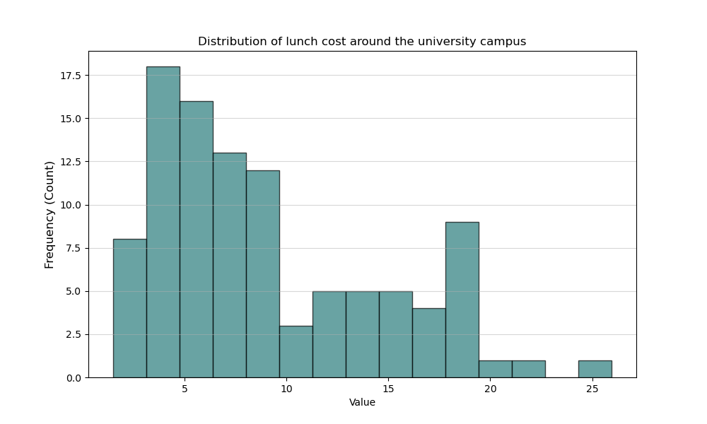

Sample1

Slide 10
The “Hard” Question: The Gap
100
...but what about all 20,000?
Did our sample of 100 students perfectly capture the true average of the entire Population? Our simple answer is now in question.
Our Sample
Notes:
Inference
A sample is likely to be a good representation of the population.
There is an element of uncertainty as to how well the sample represents the population

Slide 11

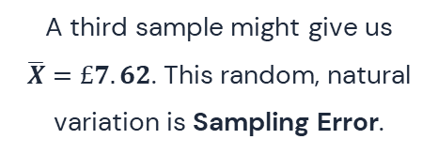
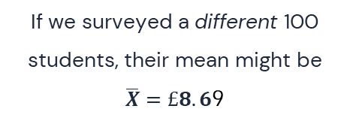
The Problem: Sampling Error
Sample 1
Sample 2
Sample 3
Our first group of 100 students had a mean of $\overline{X}=£8.94$
If we surveyed a different 100 students, their mean might be
$\overline{X}=£8.6$9
A third sample might give us
$\overline{X}=£7.62$. This random, natural variation is Sampling Error.
https://github.com/jsancheg/DemoClass/blob/main/src/Sampling_Error_Explorer.html
Notes:
There is an element of uncertainty as to how well the sample represents the population. A sample will never be a perfect representation of the population from which it is drawn. Nor will all the samples drawn from the same population be the same.
But throw simulation and probability theory, we can get an idea of what the population is likely to be like from the information a sample give us.

Slide 12
A Worse problem: Bias
"What if we only surveyed students at the expensive cafe? This is Bias: a systematic error that makes our sample unrepresentative."
Notes:
The way how the sample is taken matters

Slide 13
The Solution: Inferential Statistics
Job 2: Inferential Statistics. The toolset for managing uncertainty and making a reliable 'guess' about the whole population.
Notes:
Inferential Statistics does allow to make conclusions beyond the data we have to the population from which it was drawn.
A definition of inference is the process of drawing conclusions about
1. A sample is likely to be a good representation of the population. This happens best when each person or thing in the population has an equal chance of being selected in the sample.
For example if our orchard has only red apples of a fairly consistent size, then we would expect the sample to contain red apples of a fairly consistent size.
If our machine is producing chocolate bars with a percentage of nuts within a certain range, lets say 35%-42%, then we would expect the sample to also have nuts within that range.

Slide 14


How Inference Works
It CANNOT fix Bias. A flawed collection method (bias) will always lead to flawed conclusions.
It CAN manage Sampling Error. Inference uses the mathematics of Probability to measure the 'noise' from random sampling.
It CAN quantify uncertainty. It tells us *how good* our guess is, which is far more powerful than just guessing.
Notes:
We are interested in what sample tell us about the population.
Let’s say we have a random variable x which can take any value in [0,10], when an event occurs according to the probability distribution of X we refer to this as sampling from X, here is what we call the probability density function of x which basically tell us the probability of a sample being any of the values between [0,10]. We usually denote p(x) the density of x an interesting quantity describing the distribution of x is its expectation usually noted E[x]. It is basically the average value you can expect when sampling from x and it can be computed using the integral (area under) of the probability density function.

Slide 15
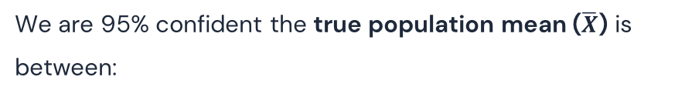
The Result: A Confident Guess
New Answer: A Confidence Interval
£8.94
We are 95% confident the true population mean ($\overline{X}$) is between:
Old Answer (A single $\overline{X}$)
[£6.83, £11.05]
Notes:
Different samples of the same populations will give different results. This is called sampling error or variation due to sampling. There will always be sampling error.
When we express an estimate of a population parameter, it is good practice to give it as a confidence interval. A confidence interval communicate how accurate our estimate is likely to be.
What affects the width of confidence interval? The width of a confidence interval depends on two things: The variation within the population of interest, and the size of the sample.
Variation within the population: Population with low variation, we will have a small confidence interval, but a more varied population will lead a more varied sample and a wider confidence interval.
Sample size: Sample size will also affects the width of a confidence interval. If we take a small sample, we do not have much information on which to base our inference. Small samples will varied much from each other, there is more variation due to the sampling error with a small samples. In larger samples, the effect of a few unusual values is evened up by the others values in the sample. Larger samples will be more similar to each other. The effect of sampling error is reduced with larger samples. When we take a large sample, we gather more information and can be more sure about our estimate. The confidence interval can be smaller. There are different methods to calculate confidence intervals: Informal, traditional Normal-based formula, and bootstrapping. When we use traditional Normal-based formula, the stated level of confidence also affects the width of the confidence interval. All estimates of population parameters such as: means, medians, difference in means, difference in medians should be expressed as confidence intervals.
The margin of error can be used to create confidence intervals. Confidence Intervals give a range within which we think the population parameter is likely to be.
In inferenial statistics, we can also test hypothesis.

Slide 16
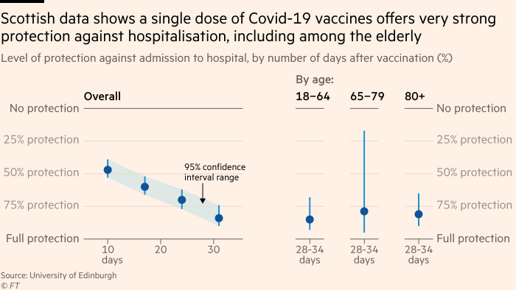


Confidence Intervals in different real-world context
Notes:
Confidence intervals are based on sample data, and give a range of possible values for a parameter. For example we could be interested in estimating the average protection against hospitalization of a single dose of Covid-19 vaccines in population. We could be interested in the average percentage of how people intent to vote before an election or, we could be interested in the average hours of TV watched per week in the UK and the USA.
In all these examples, we draw a sample. The mean of the sample is most likely different from the one of the population. Let’s assume not just one but several samples which of course we don’t actually do in practise. So, each sample is likely to show a different mean. how can we be sure about our estimate?
The true value of the parameter of interest is unknown, but we would like to have a range in which the true value of the parameter lies with a certain probability. For example, we want to know where of the mean of the population is. Therefore, we want to find out in which range the true mean value is most likely to be found. This range is called confidence interval. Thus the confidence interval give us a range in which the true value of the population parameter is likely to be found with a certain probability. Lets see an example
The true value of the parameter of interest is unknown, but we would like to express how close is our parameter estimate from the true value of the population parameter through a confidence interval

Slide 17
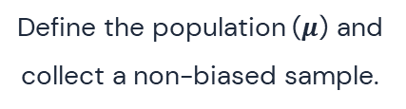
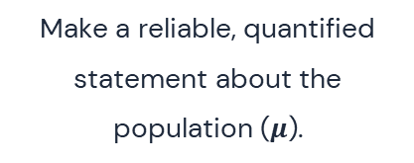
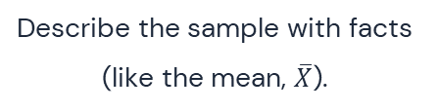
Our New Mental Model: The Roadmap
4. Conclusion
2. Descriptive Statistics
Make a reliable, quantified statement about the population ($μ$).
Describe the sample with facts (like the mean, $\overline{X}$).
1. Population & Sample
3. Inferential Statistics
Define the population ($μ$) and collect a non-biased sample.
Manage random error and create a Confidence Interval.

Slide 18

Key Takeaways
Sample vs. Population
Error vs. Bias
Descriptive Stats are facts about your Sample ($\overline{X}$).
Sampling Error is a random, manageable part of the process.
Inferential Stats are educated guesses about the Population ($μ$).
Bias is a systematic, fatal flaw in your method.
Notes:
In Statistics, parameters of the population are often estimated based on a sample. Therefore, on the one hand we have the population, but in most cases we cannot survey the entire population or we do not have data about the entire population we draw a sample. We want to use this sample to estimate a parameter of the population.
For example, parameters that can be estimated are the mean and the variance. Let’s look at some real applications of confidence intervals.

Slide 19
Questions?
Thank you.
Notes:
In Statistics, parameters of the population are often estimated based on a sample. Therefore, on the one hand we have the population, but in most cases we cannot survey the entire population or we do not have data about the entire population we draw a sample. We want to use this sample to estimate a parameter of the population.
For example, parameters that can be estimated are the mean and the variance. Let’s look at some real applications of confidence intervals.

Slide 20
Example
What is the average number of hours per day young adults (18 to 30 years old) in the UK spend on their smartphones?
Variable – number of hours per day spent on smartphones.
Population – young adults (18 to 30 years old) in the UK.
Sample – A representative selection of the young adult population in the UK.
Parameter – The average number of hours per day spent on smartphones.
Statistics (estimate) – The average number of hours per day spent on smartphones
Each sample will give a slightly different estimate for the number of hours per day young adults in the UK spend on their smartphones. This is known as sampling error.
Notes:
Answering our question of interest, our parameter the think that we are trying some inference about will be the mean of hours per day spent on smarphones. The difference between the variables the number of hours per day spend on smartphones and the parameter for that variable the average of number of hours per day spent on smatphones.
The parameter is related to the population and the statistics is related to samples. It is important to be able to distinguish between these two concepts.
The statistics would be the average number of hours per day for the sample. If we conduct our sampling properly and the dataset is informative enough, then our statistics the average number of hours per day Young aduls spend on their smartphones, should provide us information about the parameter, the average number of hours per day youn adults spend on their smartphones. The statistics would not provide all the information, but it should provide us enough that we can make some sort of Good inference about it.
Each sample would give you a slightly different estimate even if we sample from the same population.

Slide 21
Statistics
The major aim of Statistics
Draw inferences (i.e. make conclusions based on evidence).
About the value of parameters in the population of interest.
Based upon the observed values of summary statistics from the actual sample obtained.
Notes:
The major aim of statistics is to draw inferences and derived conclusions based on evidence. You observe something and from that you draw a conclusions. You extract information from something in order to make your conclusion as an inference. You usually do this for values of parameters that relate to the population of interest, and that is based on observed value of statistics.
Some statistics that are from your sample.

Slide 22
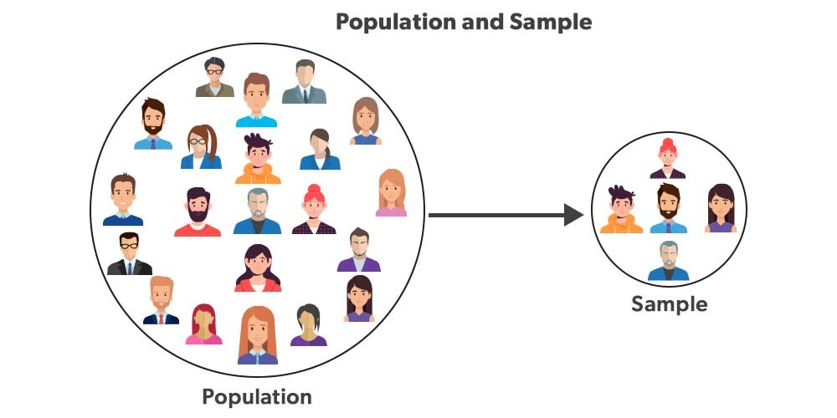
What is the confidence interval?
Notes:
In Statistics, parameters of the population are often estimated based on a sample. Therefore, on the one hand we have the population, but in most cases we cannot survey the entire population or we do not have data about the entire population we draw a sample. We want to use this sample to estimate a parameter of the population.
For example, parameters that can be estimated are the mean and the variance. Let’s look at some real applications of confidence intervals.

Slide 23
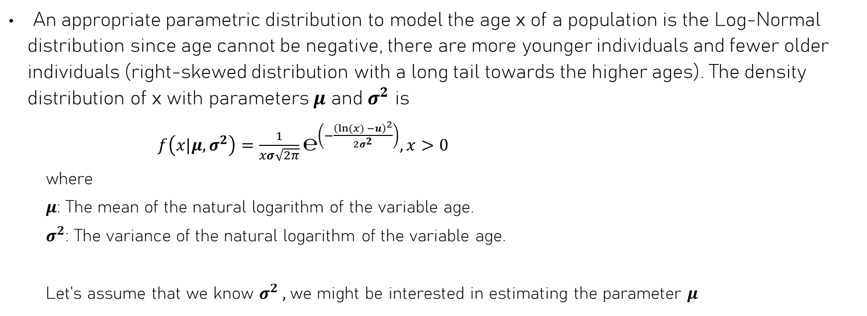
Age population
An appropriate parametric distribution to model the age x of a population is the Log-Normal distribution since age cannot be negative, there are more younger individuals and fewer older individuals (right-skewed distribution with a long tail towards the higher ages). The density distribution of x with parameters $μ$ and $σ^{2}$ is
$f\left(x|μ,σ^{2}\right)=\frac{1}{xσ\sqrt{2π}}℮^{\left(−\frac{{\left(ln⁡(x) −u\right)}^{2}}{2σ^{2}}\right)}, x>0$
where
$μ$: The mean of the natural logarithm of the variable age.
$σ^{2}$: The variance of the natural logarithm of the variable age.
Let’s assume that we know $σ^{2} ,$we might be interested in estimating the parameter $μ$
Notes:
Let’s assume that our population is people who buy a specific product, and we are interested in the average age of this population. Thus, we draw a sample of this population, and we want to inference the average age of the population.

Slide 24
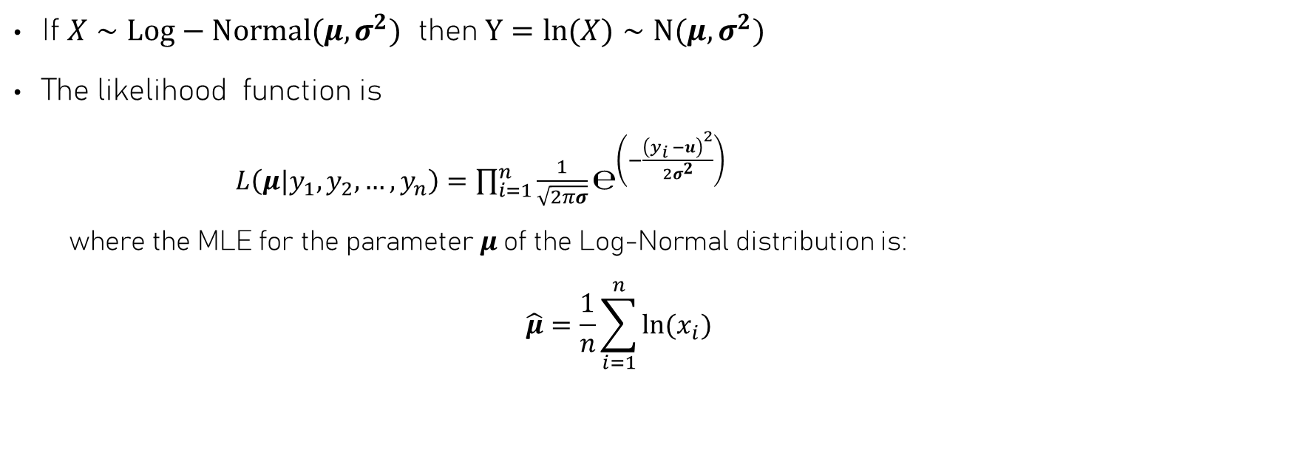
MLE estimates for μ and σ
If $X∼Log−Normal⁡(μ,σ^{2})$ then $Y=ln(X)∼N⁡(μ,σ^{2})$
The likelihood function is
$L\left(μ|y_{1},y_{2},…,y_{n}\right)=\prod_{i=1}^{n}{\frac{1}{\sqrt{2πσ}}}℮^{\left(−\frac{{\left(y_{i} −u\right)}^{2}}{2σ^{2}}\right)}$
where the MLE for the parameter $μ$of the Log-Normal distribution is:
$$\hat{μ}=\frac{1}{n}\sum_{i=1}^{n}{ln⁡(x_{i})}$$
Notes:
If mu is the mean of the natural logarithm of the variable age, then we might be interested in a confidence interval for the mean of the variable age.
To obtain a confidence interval for the mean of the variable age, we can use the invariance principle.

Slide 25
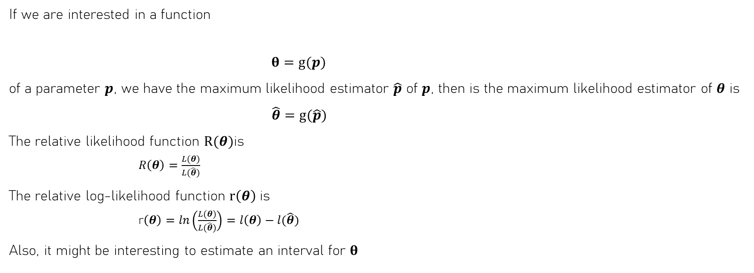
The invariance principle, relative likelihood and log- likelihood function
If we are interested in a function
$θ=g(p)$
of a parameter $p$, we have the maximum likelihood estimator $\hat{p}$ of $p$, then is the maximum likelihood estimator of $θ$ is
$\hat{θ}=g(\hat{p})$
The relative likelihood function $R(θ)$is
$R\left(θ\right)=\frac{L(θ)}{L(\hat{θ})}$
The relative log-likelihood function $r\left(θ\right)$is
r$\left(θ\right)=ln\left(\frac{L(θ)}{L(\hat{θ})}\right)=l\left(θ\right)−l(\hat{θ})$
Also, it might be interesting to estimate an interval for $θ$
Notes:
The invariance property of the MLE according to which a certain unknown parameter theta can be written as a function of another unknown parameter p. Then the maximum likelihood estimator of theta can just be obtained as a function of the maximum likelihood estimator of p. So, basically if we known the maximum likelihood estimator of p we can easily obtain the maximum likelihood estimator for theta by relying on the invariance property. This property is quite appealing because we can obtain the maximum likelihood estimate of a certain parameter as a function of the maximum likelihood estimate of another parameter that it might be easy to calculate or easier to obtain.
An useful functions are the relative likelihood function R(theta) which is the division of Likelihood of theta by Likelihood evaluated at (MLE of theta)
And the relative log-likelihood which is the log of the relative likelihood function and can be expressed as the difference between log-likelihood of theta minus the log likelihood evaluated at ( the maximum likelihood estimate of theta).
It might be useful to construct an interval for parameter theta.

Slide 26
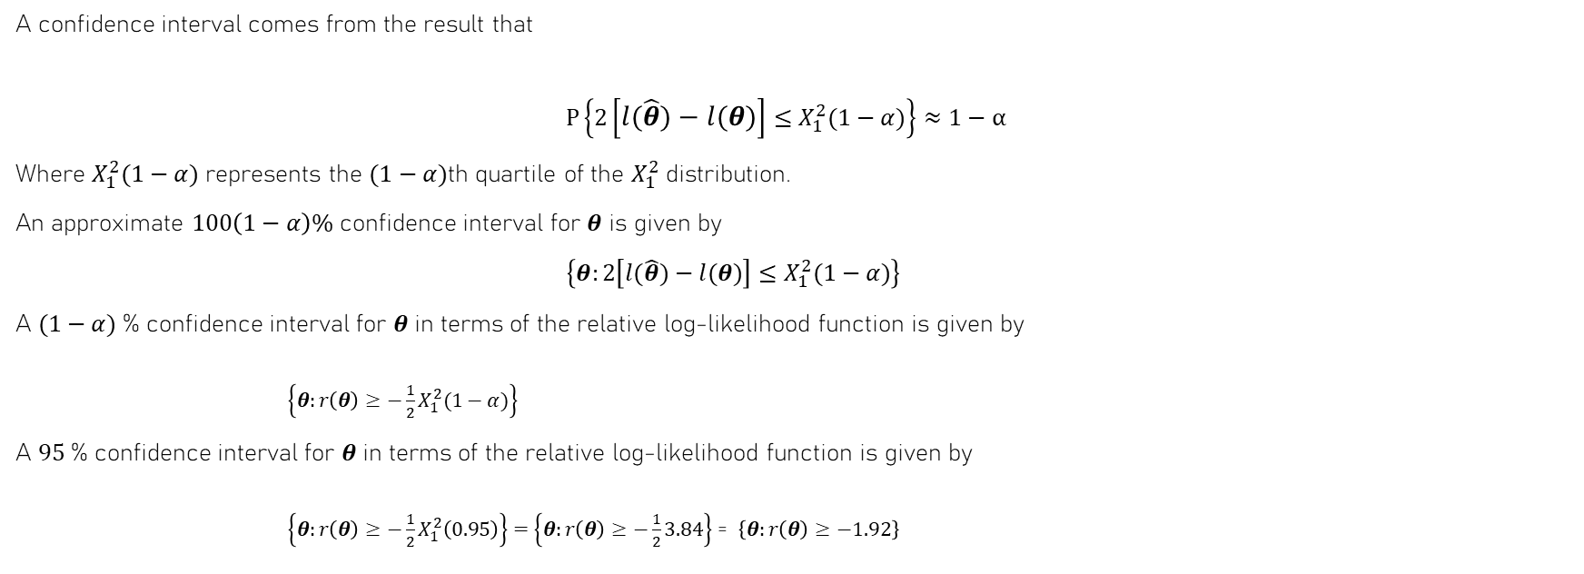
Wilks confidence intervals
A confidence interval comes from the result that
$P\left\{2\left[l(\hat{θ})−l(θ)\right]≤X_{1}^{2}(1−α)\right\}≈1−α$
Where $X_{1}^{2}(1−α)$ represents the $(1−α)$th quartile of the $X_{1}^{2}$ distribution.
An approximate $100\left(1−α\right)\%$ confidence interval for $θ$ is given by
$\left\{θ:2\left[l(\hat{θ})−l(θ)\right]≤X_{1}^{2}(1−α)\right\}$
A $(1−α)$% confidence interval for $θ$in terms of the relative log-likelihood function is given by
$\left\{θ:r\left(θ\right)≥−{\frac{1}{2}X}_{1}^{2}(1−α)\right\}$
A $95$% confidence interval for $θ$in terms of the relative log-likelihood function is given by
$\left\{θ:r\left(θ\right)≥−{\frac{1}{2}X}_{1}^{2}\left(0.95\right)\right\}=$ $\left\{θ:r\left(θ\right)≥−\frac{1}{2}3.84\right\}$ = $\left\{θ:r\left(θ\right)≥−1.92\right\}$
Notes:
As I mentioned earlier, point estimates obtained on different samples will take different values, and the point estimates calculated from a particular sample will not generally will be equal to the unknown parameter. We might be interested in using the sample data to estimate a range of plausible values that contain the true parameter with certain probability. This range of possible values for the parameter estimates is called confidence interval.
One way to construct a confidence interval is using the result that the probability that 2 times the log likelihood at theta hat minus the log-likelihood at theta noun is smaller or equal than a (1-alpha) quantile of the chi-squared distribution with one degrees of freedom occurs with probability (1-alpha) where (1-alpha) is the confidence level. If we are looking for 95% confidence level then 1-alpha is 0.95 with alpha = 0.05.
To calculate Wilks confidence intervals we might need to use numerical methods such as Newton-Rapson. Another property of the Wilks interval is that it includes the most likely values for the parameter of interest
So, (1-alpha)% confidence interval for theta is those all values of theta for which 2 times the differences of log-likelihood evaluated at theta hat and the log-likelihood evaluate at the true parameter theta is less than or equal to (1-alpha) quantile of chi-squared distribution with one degree of freedom.
If we look at these it is equivalent to all values of theta such that the relative log-likelihood function of theta is greater or equal to minus half times the (1-alpha)-quantile of the chi-squared distribution with one degrees of freedom. We know that at (1-alpha) = 0.95 the (1-alpha) quantile of the chi-squared distribution with one degree of freedom is equal to 3.84. This means that a 95% confidence interval is all values of theta such that the relative log-likelihood function of theta is greater or equal than -1.92.

Slide 27
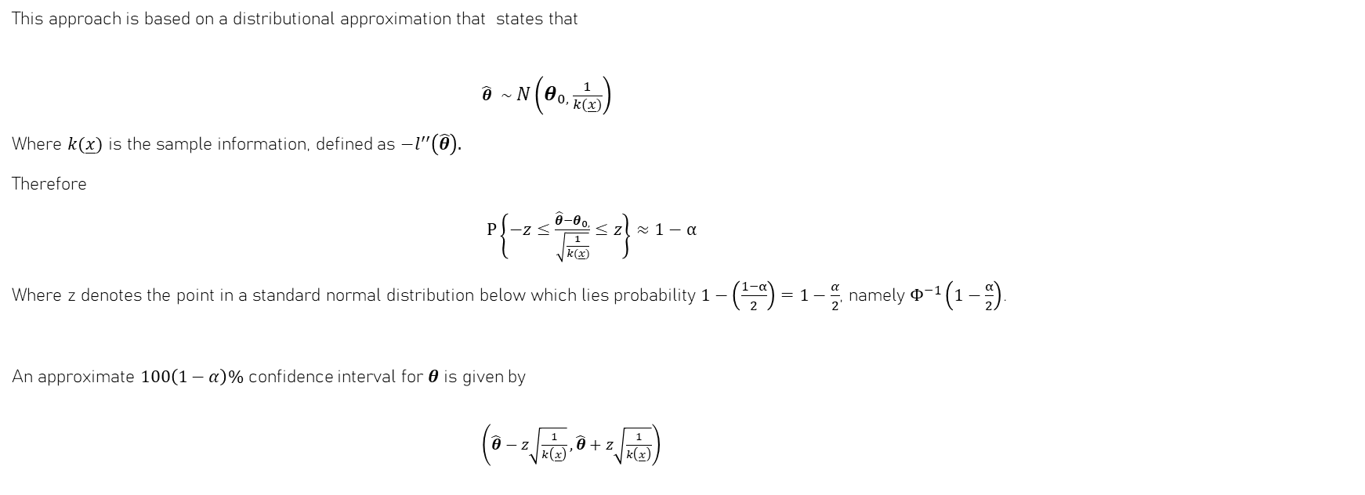
Wald confidence intervals
This approach is based on a distributional approximation that states that
$\hat{θ} ∼N\left(θ_{0,}\frac{1}{k(\underline{x})}\right)$
Where $k(\underline{x})$ is the sample information, defined as $−l^{′′}\left(\hat{θ}\right).$
Therefore
$P\left\{−z≤\frac{\hat{θ}−θ_{0,}}{\sqrt{\frac{1}{k(\underline{x})}}}≤z\right\}≈1−α$
Where z denotes the point in a standard normal distribution below which lies probability $1−\left(\frac{1−α}{2}\right)=1−\frac{α}{2}$, namely $Φ^{−1}\left(1−\frac{α}{2}\right)$.
An approximate $100\left(1−α\right)\%$ confidence interval for $θ$ is given by
$\left(\hat{θ}−z\sqrt{\frac{1}{k\left(\underline{x}\right)}},\hat{θ}+z\sqrt{\frac{1}{k\left(\underline{x}\right)}}\right)$
Notes:
Many statistics have a sampling distribution that is approximately normal. In these cases the interval will be of the form:
If the theta noun is the true variable of the parameter theta then theta hat would approximately follows a normal distribution with mean equal to theta noun and standard deviacion equal to the inverse of the sample information k of x. Here, k(x) is the equal to the negative of the second derivate of the log-likelihood function evaluated at theta hat
Thus, a (1-alpha) times 100% confidence interval can be obtained for theta from setting the probability that theta hat minus theta no over the standard error for theta hat , which is the squared root of the 1 over the sample information, being between negative z and z is equal to the confidence level (1-alpha)
Here z, is the quantile of the standard normal distribution below which lies a probability 1- alpha over 2 which is denoted by phi inverse of 1 – alpha over 2. So if (1-alpha) is equal to 0.95 then z would be the value which below we have the probability equal 0.975 and above we have an area equal to 0.025. This means that this value is 1.96. To obtain the confidence interval for theta we try to move all the terms except theta no to the left and right hand side of the equation and only left theta no in the middle. So, we will end up with the confidence interval being theta hat plus or minus z (the quantile of the standard normal distribution) multiplied by the standard error of the maximum likelihood estimate which is equal to the squared root of 1 over the sample information.
Easy to obtain easier than the Wilks intervals which needs to find the bounds by using numerical methods, but their properties are less satisfactory for finite sample sizes. Wald intervals are not invariant unlike the Wilks intervals. Different parametrization of a model will lead to different intervals. The Wald interval is symmetric around the maximum likelihood estimated, so unless the likelihood is symmetric we might end up with some values within the interval that are less likely to occur than some other values outside the interval. This unlike the Wilks interval which guaranteed all the values of theta inside the Wilks interval have a higher likelihood than any other value outside the interval.
The second derivate of the log-likelihood function evaluated at theta hat is the sample information.
Point estimate +- margin error
Not all confident intervals are constructed in this maner
There will be two main issues:
1. Using appropriate method to calculate the interval
2. Properly interpreting the resulting interval.
Theta estimate is a random variable and theta0 is a fixed unknown quantity that I am trying to estimate and its variability is due to the fact that the sample mean is a random variable.
The interval is composed of a lower bound and upper bound. The confidence interval will have a confidence level that is represented by 1-alpha that we usually express as a percentage

Slide 28

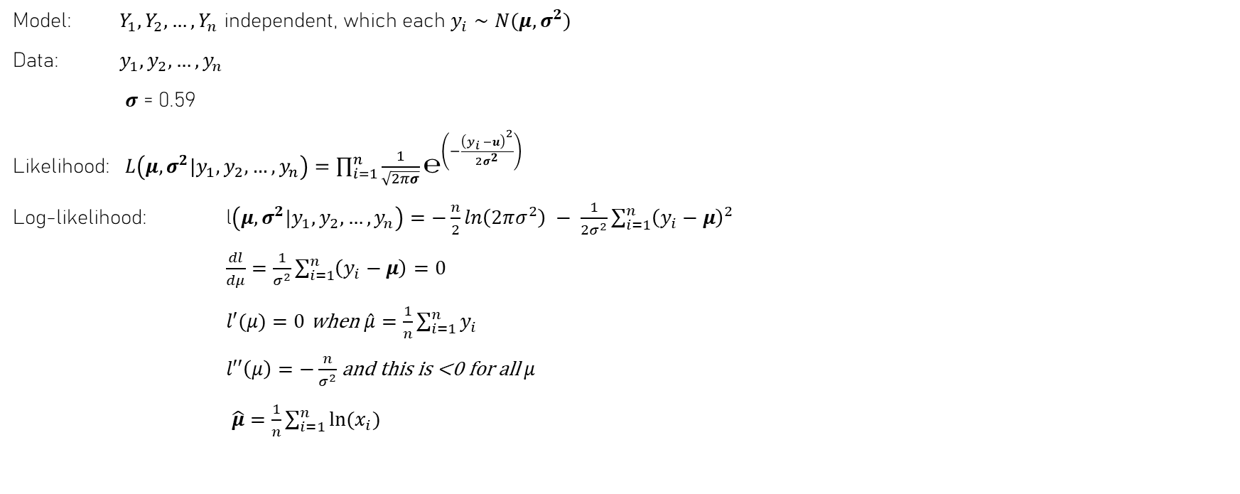
Confidence interval for $μ$ when $σ$ is known
Model: $Y_{1},Y_{2},…,Y_{n}$ independent, which each $y_{i}∼N(μ,σ^{2})$
Data: $y_{1},y_{2},…,y_{n}$
$σ$ = 0.59
Likelihood: $L\left(μ,σ^{2}|y_{1},y_{2},…,y_{n}\right)=\prod_{i=1}^{n}{\frac{1}{\sqrt{2πσ}}}℮^{\left(−\frac{{\left(y_{i} −u\right)}^{2}}{2σ^{2}}\right)}$
Log-likelihood: l$\left(μ,σ^{2}|y_{1},y_{2},…,y_{n}\right)=−\frac{n}{2}ln\left(2πσ^{2}\right) − \frac{1}{2σ^{2}}\sum_{i=1}^{n}{{\left(y_{i}−μ\right)}^{2}}$
$\frac{dl}{dμ}=\frac{1}{σ^{2}}\sum_{i=1}^{n}{\left(y_{i}−μ\right)=0}$
$l′(μ)=0$ when $\hat{μ}=\frac{1}{n}\sum_{i=1}^{n}{y_{i}}$
$l′′\left(μ\right)=−\frac{n}{σ^{2}}$ and this is <0 for all $μ$
$\hat{μ}=\frac{1}{n}\sum_{i=1}^{n}{ln⁡(x_{i})}$

Slide 29

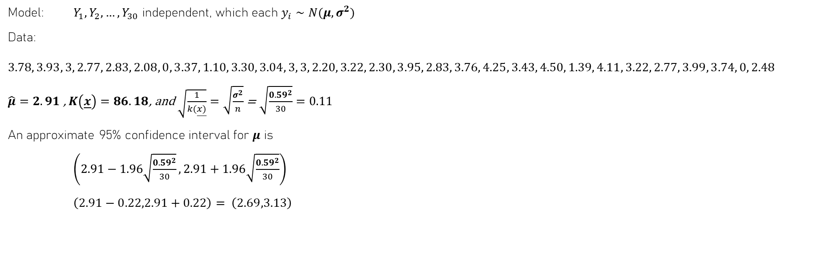
Confidence interval for $μ$ when $σ$ is known
Model: $Y_{1},Y_{2},…,Y_{30}$ independent, which each $y_{i}∼N(μ,σ^{2})$
Data: $3.78, 3.93, 3, 2.77, 2.83, 2.08, 0, 3.37, 1.10, 3.30, 3.04, 3, 3, 2.20, 3.22, 2.30, 3.95, 2.83, 3.76, 4.25, 3.43, 4.50, 1.39, 4.11, 3.22, 2.77, 3.99, 3.74, 0, 2.48$
$\hat{μ}=2.91$ , $K\left(\underline{x}\right)=86.18$, and $\sqrt{\frac{1}{k(\underline{x)}}}=\sqrt{\frac{σ^{2}}{n}}$ = $\sqrt{\frac{{0.59}^{2}}{30}}=0.11$
An approximate 95% confidence interval for $μ$ is
$\left(2.91−1.96\sqrt{\frac{{0.59}^{2}}{30}},2.91+1.96\sqrt{\frac{{0.59}^{2}}{30}}\right)$
$\left(2.91−0.22,2.91+0.22\right)= \left(2.69,3.13\right)$

Slide 30
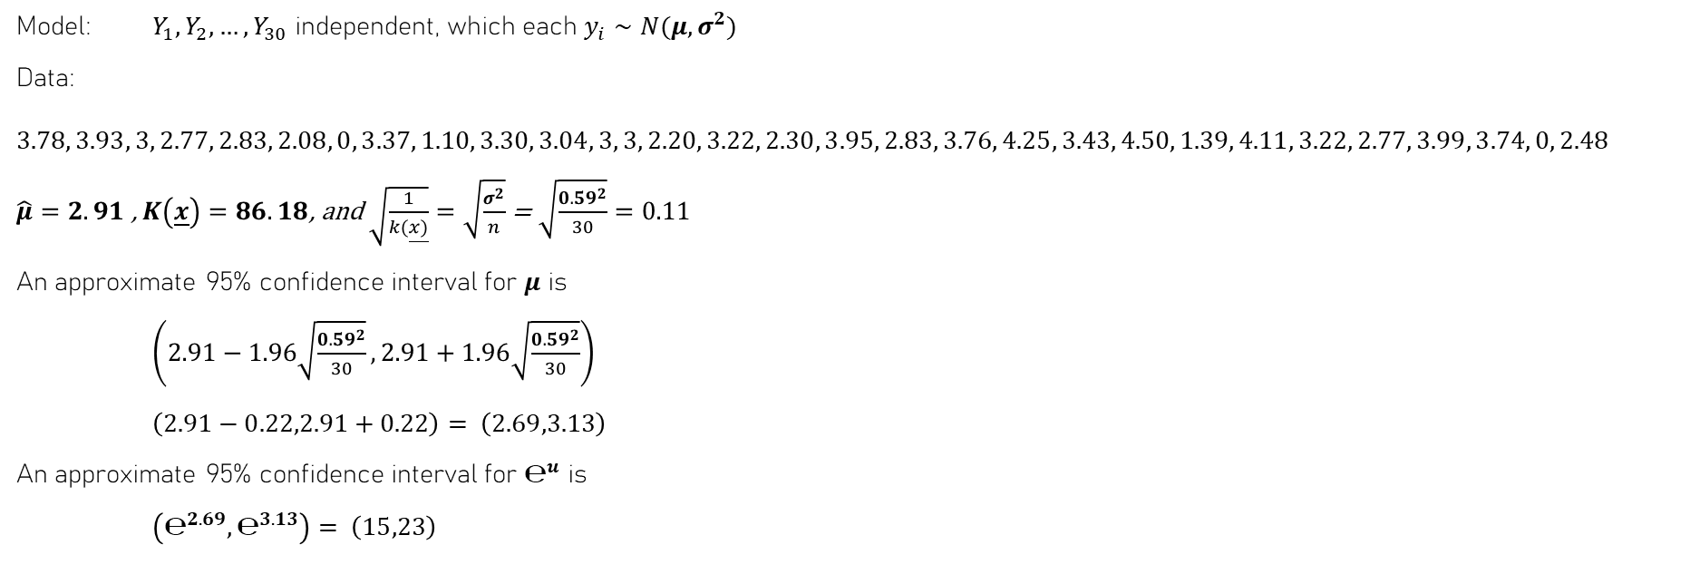
Confidence interval for $μ$ when $σ$ is known
Model: $Y_{1},Y_{2},…,Y_{30}$ independent, which each $y_{i}∼N(μ,σ^{2})$
Data: $3.78, 3.93, 3, 2.77, 2.83, 2.08, 0, 3.37, 1.10, 3.30, 3.04, 3, 3, 2.20, 3.22, 2.30, 3.95, 2.83, 3.76, 4.25, 3.43, 4.50, 1.39, 4.11, 3.22, 2.77, 3.99, 3.74, 0, 2.48$
$\hat{μ}=2.91$ , $K\left(\underline{x}\right)=86.18$, and $\sqrt{\frac{1}{k(\underline{x)}}}=\sqrt{\frac{σ^{2}}{n}}$ = $\sqrt{\frac{{0.59}^{2}}{30}}=0.11$
An approximate 95% confidence interval for $μ$ is
$\left(2.91−1.96\sqrt{\frac{{0.59}^{2}}{30}},2.91+1.96\sqrt{\frac{{0.59}^{2}}{30}}\right)$
$\left(2.91−0.22,2.91+0.22\right)= \left(2.69,3.13\right)$
An approximate 95% confidence interval for $℮^{u}$ is
$\left(℮^{2.69},℮^{3.13}\right)= \left(15,23\right)$

